Slide 1
Classes, Objects and Methods
by
Jamimamul Bakas
Acknowledgment
The contents of the slides are taken from the followings:
Java- One Step Ahead by A. Seth and B.L. Juneja
The Complete Reference by H. Schildt

Slide 2
Class
A class is declared by use of the class keyword
The data, or variables, defined within a class are called instance variables.
The code is contained within methods. Collectively, the methods and variables defined within a class are called members of the class.
A simplified general form of a class definition is shown here:
class classname {
type instance-variable1;
type instance-variable2;
// ...
type instance-variableN;
type methodname1(parameter-list) {
// body of method
}
type methodname2(parameter-list) {
// body of method
}
// ...
type methodnameN(parameter-list) {
// body of method
}
}

Slide 3
A Simple Class
A class called Box that defines three instance variables: width, height, and depth.
Currently, Box does not contain any methods.
class Box {
double width;
double height;
double depth;
}

Slide 4
Types of classes
Top-level class: It is a class that is not a nested class.
Nested class: It is a class that is declared within the body of another class or interface.
Types of nested classes:
Nested static class: It is like any other static member of the enveloping class.
Nested non-static classes are also called inner classes and it can be classified as follows:
Member inner class: It has properties like any other member of the outer class.
Local class: A local class is defined within a method or code block.
Anonymous class: As the name indicates, it is the inner class without a name.

Slide 5
Types of classes
Types of nested classes:
Derived class or subclass: It is a class that is derived from (or extends) another class.
Super class: It is a class from which another class or other classes are derived.
Final class: It is a class that cannot be extended.

Slide 6
Class Modifiers

Slide 7
Class Members
The class members are declared in the body of a class.
These may comprise fields (variables in a class), methods, nested classes, and interfaces.
The members of a class comprise the members declared in the class as well as the members inherited from a super class.

Slide 8
Types of Class Members
Types of variables:
Non-static variables: These include local and instance variables and
varies in scope and value.
Instance variables: These variables are individual to an object and an object keeps a copy of these variables in its memory.
Local variables: These are local in scope and not accessible outside their scope.
Class variables: These variables are also qualified as static variables.
The values of these variables are common to all the objects of the class.
The class keeps only one copy of these variables and all the objects share the same copy.
As class variables belong to the whole class, these are also called class variables.

Slide 9
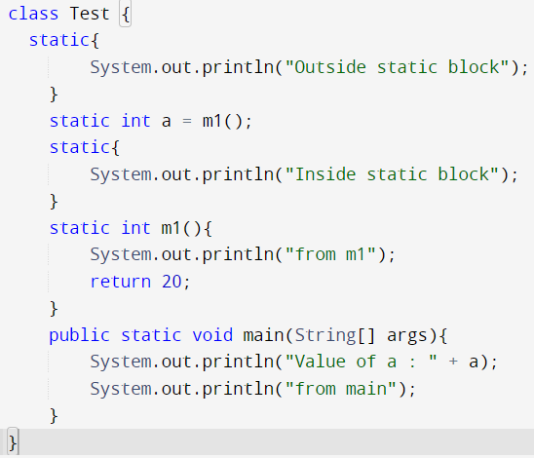
Static Class Members
We can create static variables at class level only.
Static variables can be accessed using class name.
All instances of the class share the same static variable.
static block and static variables are executed in the order they are present in a program.

Slide 10
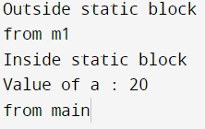
Static Class Members
We can create static variables at class level only.
Static variables can be accessed using class name.
All instances of the class share the same static variable.
static block and static variables are executed in the order they are present in a program.

Slide 11
Non-Static Class Members
Instance Variable
Non static variables can be accessed using instance of a class.
Non static variables cannot be accessed inside a static method.
In non Static variable Memory is allocated each time an instance of the class is created.
Non Static variables Exists for the lifetime of the object.
Unlike local variables, we may use access specifiers for instance variables.
Initialisation of Instance Variable is not Mandatory. Its default value is 0
Local Variable
These variables are created when the block in entered or the function is called and destroyed after exiting from the block or when the call returns from the function.
Initialisation of Local Variable is Mandatory.

Slide 12
Introduction to Method()
As stated earlier, method() is a member of classes.
A method definition comprises two components:
Header that includes modifier, type, identifier, or name of method and a list of parameters.
The parameter list is placed in a pair of parentheses.
2. Body that is placed in braces ({ }) and consists of declarations and executable statement and other expressions.
Method definition:
Modifier return_type method_indentifier(type Parameter_Name,…)
{/*Statements*/}

Slide 13
Method Example

Slide 14
Method Type
The type of a method is same as the type of data it returns.
- If it returns int number, its type is int;
- if it returns a double number, its type is double;
- if it returns a string of characters (an object of class String), its type is
String;
- if it returns a character or an array of characters, its type is char and if
it returns an object of a class, its type is the name of class.
- If it does not return any data/object, its type is void.
The return type could be any valid data type in Java.

Slide 15
Introduction to Object
As stated, a class defines a new type of data. In this case, the new data type is called Box.
Box name is used to declare objects of type Box.
It is important to remember that a class declaration only creates a template; it does not create an actual object.
To actually create a Box object, you will use a statement like the following:
Box mybox = new Box(); // create a Box object called mybox
After this statement executes, mybox will be an instance of Box. Thus, it will have “physical” reality.
The dot operator links the name of the object with the name of an instance variable.
For example, to assign the width variable of mybox the value 100, you would use the following statement:
mybox.width = 100;

Slide 16
Declaring an object
Use new operator to declare an object as follows:
Box mybox = new Box();
This statement combines the two steps just described. It can be rewritten like this to show each step more clearly:
Box mybox; // declare reference to object
mybox = new Box(); // allocate a Box object
The first line declares mybox as a reference to an object of type Box. At this point, mybox does not yet refer to an actual object.
The next line allocates an object and assigns a reference to it to mybox. After the second line executes, you can use mybox as if it were aBox object.
But in reality, mybox simply holds, in essence, the memory address of the actualBox object.

Slide 17
An Example: Class and object
/* A program that uses the Box class. Call this file BoxDemo.java */
class Box {
double width;
double height;
double depth;
}
// This class declares an object of type Box.
class BoxDemo {
public static void main(String args[]) {
Box mybox = new Box();
double vol;
// assign values to mybox's instance variables
mybox.width = 10;
mybox.height = 20;
mybox.depth = 15;
// compute volume of box
vol = mybox.width * mybox.height * mybox.depth;
System.out.println("Volume is " + vol);
}
}

Slide 18
Difference between an object reference and pointers in C/C++
Those readers familiar with C/C++ have probably noticed that object references appear to be similar to pointers. This suspicion is, essentially, correct.
An object reference is similar to a memory pointer.
The main difference—and the key to Java’s safety—is that you cannot manipulate references as you can actual pointers.
Thus, you cannot cause an object reference to point to an arbitrary memory location or manipulate it like an integer.

Slide 19
Access Control for Class Members
Three access specifiers are permitted:
public
protected
private
The coding with access specifiers for variables is illustrated as
Access_specifier type identifier;

Slide 20
Access Control for Class Members

Slide 21
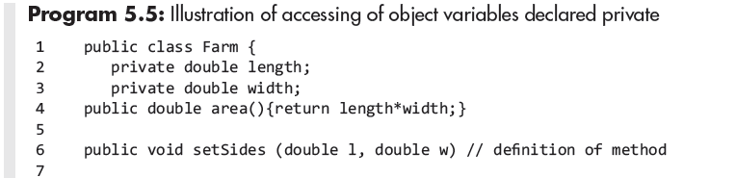
Accessing Private variables of a Class

Slide 22
Access Control for Class Members
If a top-level class is declared as private the compiler will complain that the modifier private is not allowed here. This means that a top-level class cannot be a private, the same can be applied to protected access specifier also.
Protected means that the member can be accessed by any class in the same package and by subclasses even if they are in another package.
The top-level classes can only have public, abstract and final modifiers, and it is also possible to not define any class modifiers at all. This is called default/package accessibility.
We can declare the inner classes as private or protected, but it is not allowed in outer classes.
More than one top-level class can be defined in a Java source file, but there can be at most one public top-level class declaration. The file name must match the name of the public class.

Slide 23
Accessing Private Methods of a Class

Slide 24
Continue

Slide 25
Constructor
A constructor initializes an object immediately upon creation.
Once defined, the constructor is automatically called when the object is created, before the new operator completes.
Constructor’s job is to initialize the internal state of an object so that the code creating an instance will have a fully initialized, usable object immediately.
Class name and constructor name must be same.
Unlike method, constructor does not have return type, not even void.
Constructor return the object to class, it’s implicitly done by java runtime

Slide 26
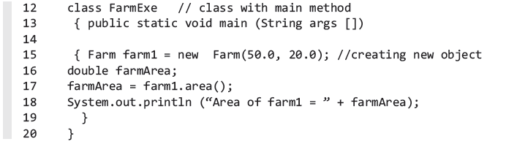
Constructor: An Example

Slide 27
Types of Constructor
There are three types of constructor in java.
Default Constructor
No-Args constructor
Parameterized constructor

Slide 28
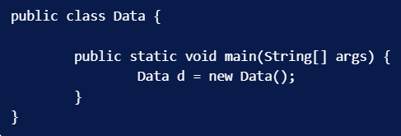
Default Constructor
If we don’t provide a constructor, then java provides default constructor implementation for us to use.
Default constructor only role is to initialize the object and return it to the calling code.
Default constructor is always without argument and provided by java compiler only when there is no existing constructor defined.
Most of the time we are fine with default constructor itself as other properties can be accessed and initialized through getter setter methods.

Slide 29
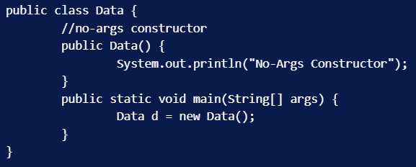
No-args Constructor
Constructor without any argument is called a no-args constructor.
It’s like overriding the default constructor and used to do some pre-initialization stuff such as checking resources, network connections, logging, etc.
Output: No-Args Constructor

Slide 30
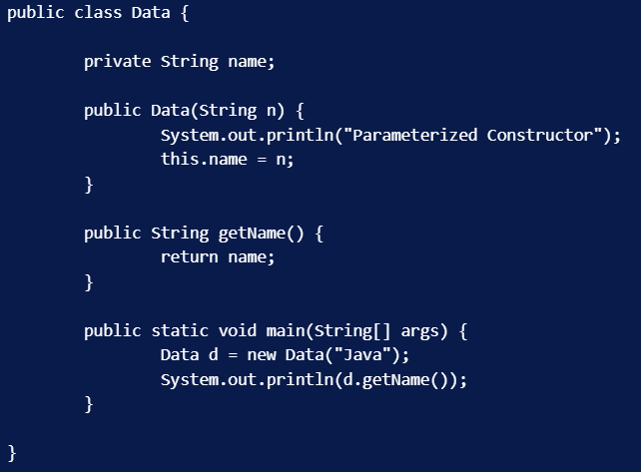
Parameterized Constructor
Constructor with arguments is called parameterized constructor.
Output
Parameterized Constructor
Java

Slide 31
Private Constructor in Java
Constructor cannot be final, abstract and static.
Using public and default access is allowed.
But what is the use of making a constructor private?
In that case any other class won’t be able to create the instance of the class. Well, a constructor is made private in case we want to implement singleton design pattern.

Slide 32
Member Inner Class
The following points regarding non-static nested classes should be noted.
The inner class has access to all the members of the enveloping class including the members declared public, protected, or private.
The enveloping class does not have direct access to nested class members. It is only through the reference of inner class.
An instance of inner class outside the enveloping class can only be created with an instance of outer class.
The object of inner (nested) class may be declared only in the scope of outer (enveloping) class.
A method of inner class cannot be directly accessed by the object of outer class. The access is through the object of inner class by a fully qualified name for accessing, which is given in the following example.

Slide 33
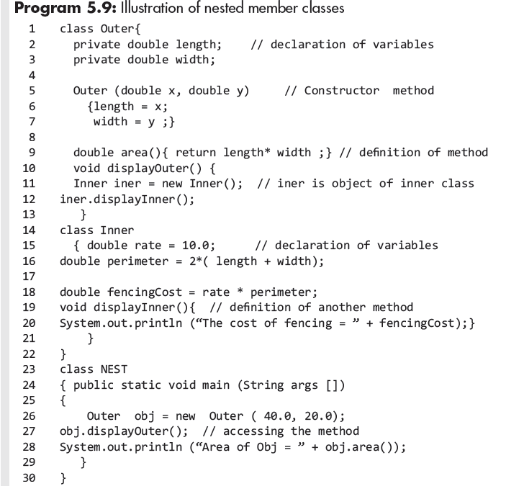
Member Inner Class: An Example

Slide 34
Member Inner Class: Another Example

Slide 35
Anonymous Class
These classes are inner classes without a name.
It is defined inside another class.
Because class has no name it cannot have a constructor method and
its objects cannot be declared outside the class.
An anonymous class must be defined and initialized in a single
expression.
An anonymous class may be used where the class has to be used
only once.
An anonymous class is defined by operator new followed by class name it extends, argument list for the constructor of super class, and then, the anonymous class body.
new class-name ([argument list]){class body}

Slide 36
Anonymous Class
The general rules for an anonymous class :
It must extend a super class or implement an interface.
An anonymous class can either extend a class or implement an interface but not both. it cannot implement multiple interfaces.
It must implement all the abstract methods of super class or interface.
If it extends a super class, the anonymous class uses the default
constructor from super class to create an instance.
An anonymous class can access all the members of enveloping class and can access the variables declared final in the enveloping class.
An anonymous class is used only once and is defined when it has to be used.

Slide 37
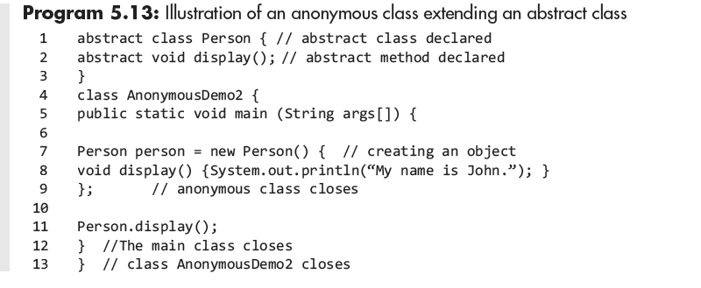
Anonymous Class: An Example

Slide 38
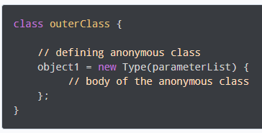
Anonymous Class
In Java, a class can contain another class known as nested class. It's possible to create a nested class without giving any name.
A nested class that doesn't have any name is known as an anonymous class.
An anonymous class must be defined inside another class. Hence, it is also known as an anonymous inner class. Its syntax is:
The above code creates an object, object1, of an anonymous class at runtime.
Anonymous classes are defined inside an expression. So, the semicolon is used at the end of anonymous classes to indicate the end of the expression.
Anonymous classes usually extend subclasses or implement interfaces.

Slide 39
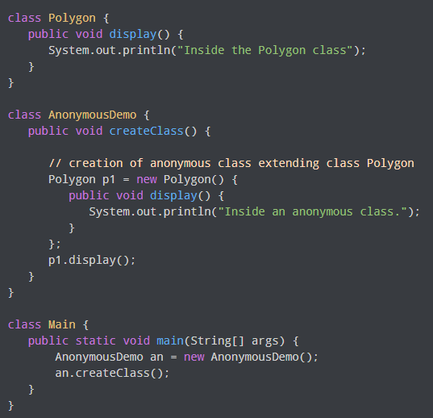
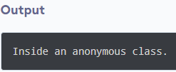
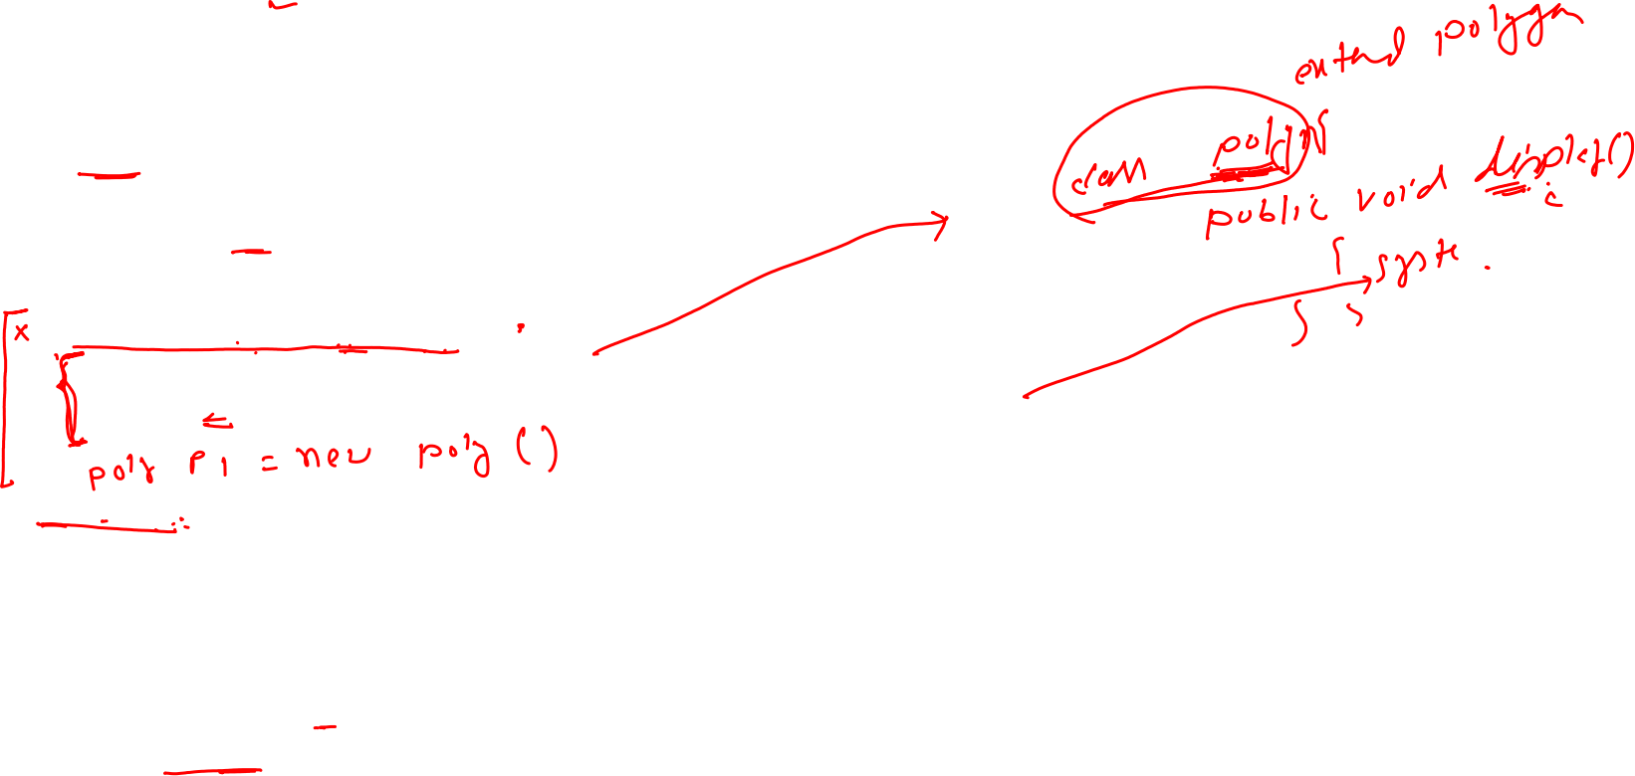
Example 1: Anonymous Class Extending a Class

Slide 40
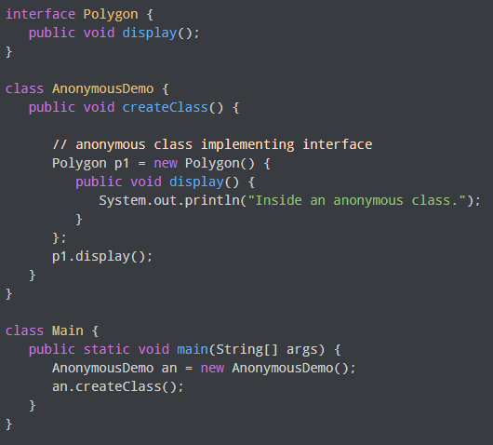


Example 2: Anonymous Class Implementing an Interface

Slide 41
Local class
These classes can refer to local variables or parameters, which are declared final.
These are not visible outside the block in which they are declared, and hence, the access modifiers such as public, private, or protected do not apply to local classes.

Slide 42
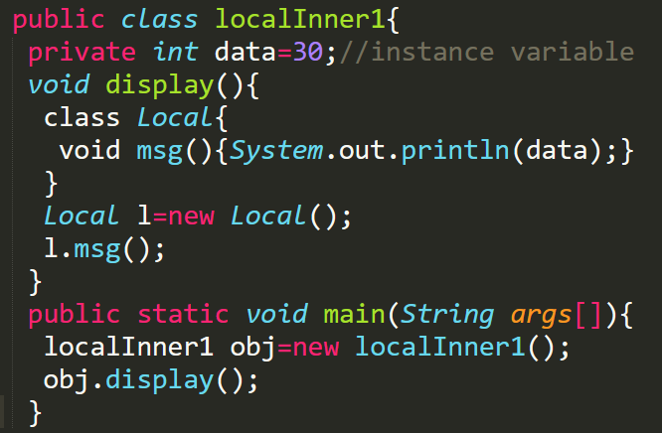
Local class: An Example

Slide 43
Static Nested Class
It may be declared public, private, or protected.
These classes can access only static instance variables and methods.
Their reference is not attached to outer class reference.
Their object may be accessed directly. For the access, the fully qualified name is not needed.
An instance of outer class is not needed for declaring the instance of nested static class outside the outer class.
The nested static class may be accessed inside the main method without the reference of outer class.
The class may be imported to a program by static import.
It may simply be referred to by its class name.

Slide 44
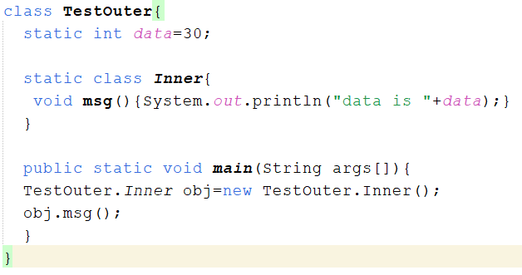
Static Nested Class: An Example

Slide 45
Final Class and Method
A class that is declared final cannot have a subclass.
This feature is provided in Java so that we may create an immutable class like the String class.
String class in java. lang package is defined as final class.
This ensures that whenever a method or an object uses a string, java.lang.String is accessed and not some other string class.
Final method cannot be overridden.

Slide 46
Final Class and Method: An Example

Slide 47
Abstract Class
These are those classes having one or more abstract methods.
The basic idea is to provide a generic concept instead of a specific class that performs some specific function.
An abstract method provides declaration only and does not contain any implementation.
An abstract class cannot be used to instantiate objects directly with the new operator.

Slide 48
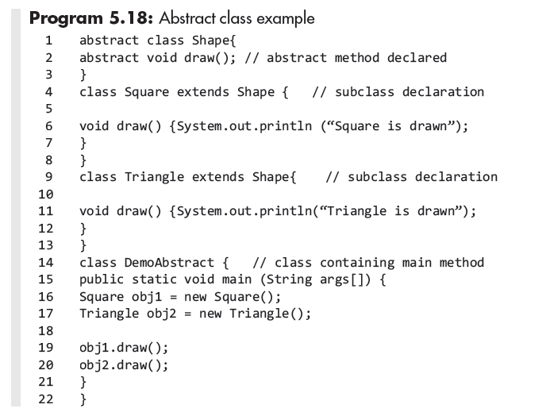
Abstract Class: An Example

Slide 49
Keyword this
The keyword this provides reference to the current object.
this or super Must Be the First Statement in the Constructor

Slide 50
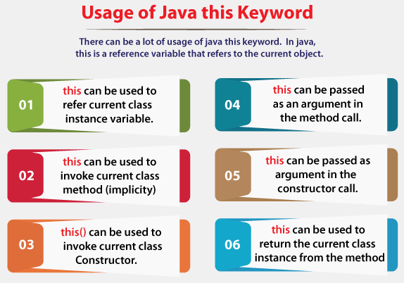
Keyword this

Slide 51
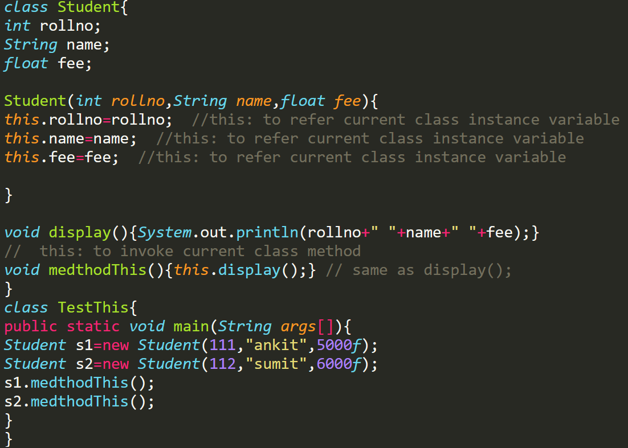
this: to refer current class instance variable this: to invoke current class method

Slide 52
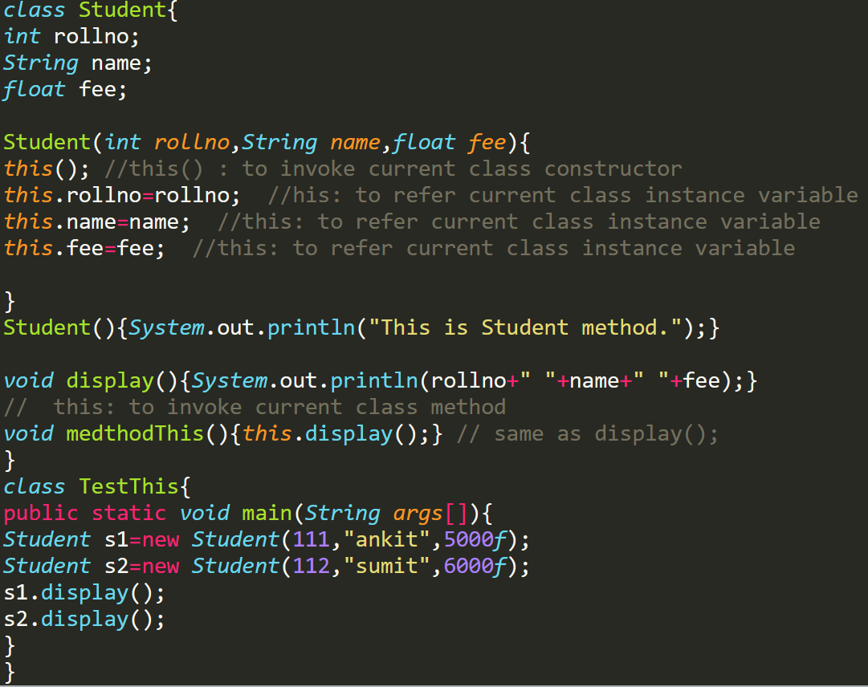
this() : to invoke current class constructor

Slide 53
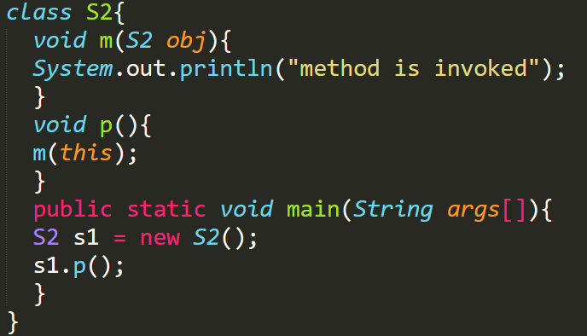
this: to pass as an argument in the method
The this keyword can also be passed as an argument in the method. It is mainly used in the event handling

Slide 54
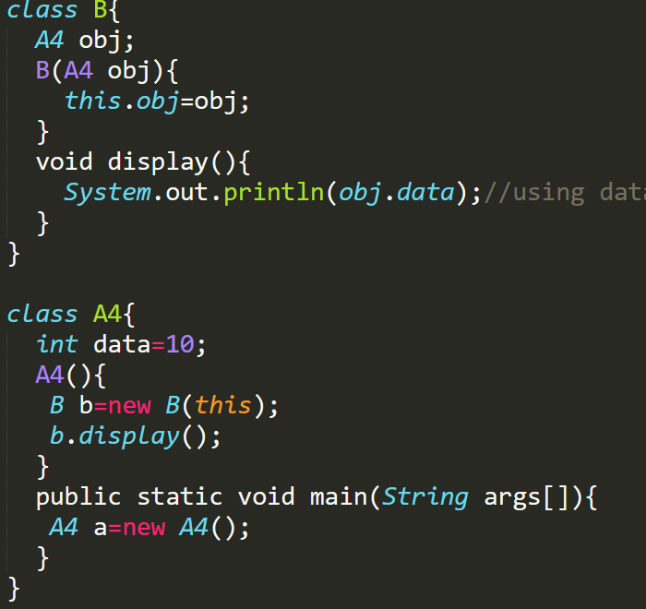
this: to pass as argument in the constructor call
We can pass the this keyword in the constructor also. It is useful if we have to use one object in multiple classes.

Slide 55
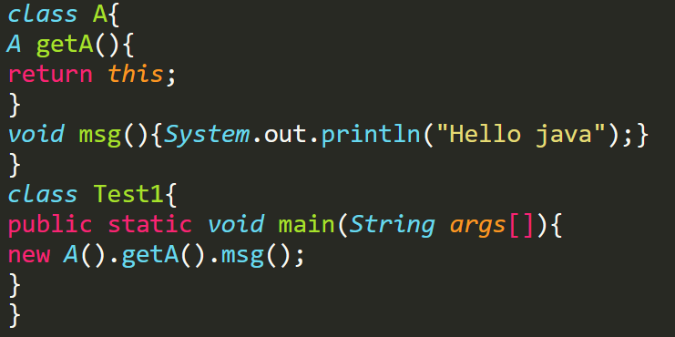
this keyword can be used to return current class instance
We can return this keyword as an statement from the method. In such case, return type of the method must be the class type (non-primitive).

Slide 56
Instance Variable Hiding
There may be cases where the names of instance variables and that of the local variable in a method is the same.
In such cases, the local variables of the method shadow the instance variable, thereby hiding them.

Slide 57
Garbage Collection
The objects that are no longer needed by the program are garbaged out.
It is a mechanism provided by JVM to reclaim the space from objects that are no longer referenced by the program.
It is an automatic process and periodically frees some memory.
When the object is no longer referenced by the program, the occupied heap space is recycled.
Garbage collection is done by daemon thread.
Garbage collection thread invokes finalize() method of that object and peforms the clean up action.

Slide 58
The finalize() method
Sometimes an object will need to perform some action when it is destroyed. For example, if an object is holding some non-Java resource such as a file handle or character font, then you might want to make sure these resources are freed before an object is destroyed. To handle such situations, Java provides a mechanism called finalization.
By using finalization, you can define specific actions that will occur when an object is just about to be reclaimed by the garbage collector.
To add a finalizer to a class, you simply define the finalize( ) method. The Java run time calls that method whenever it is about to recycle an object of that class.
Inside the finalize( ) method, you will specify those actions that must be performed before an object is destroyed.
The garbage collector runs periodically, checking for objects that are no longer referenced by any running state or indirectly through other referenced objects. Right before an asset is freed, the Java run time calls the finalize( ) method on the object.
The finalize( ) method has this general form:
protected void finalize( )
{
// finalization code here
}

Slide 59
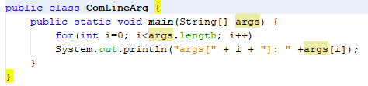

Command-Line Arguments
A command-line argument is the information that directly follows the program’s name on the command line when it is executed.
It is accomplished by passing command-line arguments to main( ).
Arguments are stored as strings in a String array passed to the args parameter of main( ). The first
Command-line argument is stored at args[0], the second at args[1], and so on.
Execute:
Output:

Slide 60
Argument passing
Two ways that a computer language can pass an argument to a subroutine: call by value and call by reference.
Call by value approach copies the value of an argument into the formal parameter of the subroutine.
Changes made to the parameter of the subroutine have no effect on the argument.
Call by reference- a reference to an argument (not the value of the argument) is passed to the parameter.
Although Java uses call-by-value to pass all arguments, the precise effect differs between whether a primitive type or a reference type is passed.
When you pass a primitive type to a method, it is passed by value.
When you pass an object to a method, it is effectively call by reference.

Slide 61
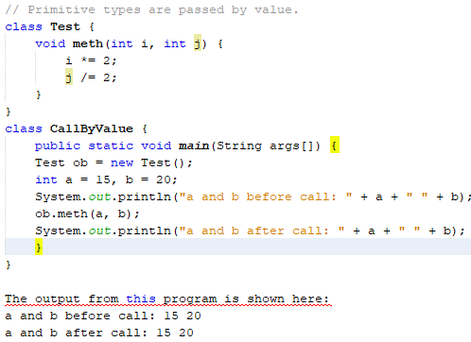
Call by value

Slide 62
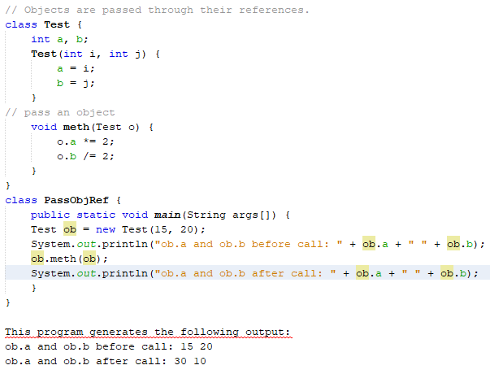
Call by reference

Slide 63
Overloading Methods
Methods with the same name and scope are permitted provided they have different signatures that include:
1. Number of parameters
2. Types of parameter
3. Their order in the parameter list

Slide 64
Overloading Methods

Slide 65
Overloading Methods: Example

Slide 66
Overloading Method
Why Method Overloading is not possible by changing the return type of method only?
because of ambiguity.
class Adder{
static int add(int a,int b){return a+b;}
static double add(int a,int b){return a+b;}
}
class TestOverloading3{
public static void main(String[] args){
System.out.println(Adder.add(11,11));//ambiguity
}
}

Slide 67
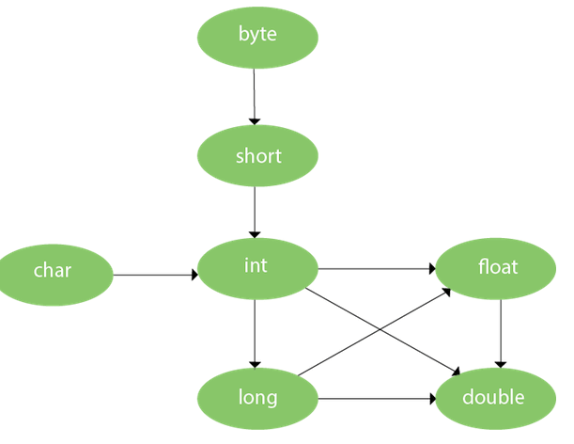

Method Overloading and Type Promotion
One type is promoted to another implicitly if no matching datatype is found. Let's understand the concept by the figure given below:

Slide 68
Example of Method Overloading with Type Promotion
class OverloadingCalculation1{
void sum(int a,long b){System.out.println(a+b);}
void sum(int a,int b,int c){System.out.println(a+b+c);}
public static void main(String args[]){
OverloadingCalculation1 obj=new OverloadingCalculation1();
obj.sum(20,20);//now second int literal will be promoted to long
obj.sum(20,20,20);
}
}

Slide 69
Example of Method Overloading with Type Promotion if matching found
class OverloadingCalculation2{
void sum(int a,int b){System.out.println("int arg method invoked");}
void sum(long a,long b){System.out.println("long arg method invoked");}
public static void main(String args[]){
OverloadingCalculation2 obj=new OverloadingCalculation2();
obj.sum(20,20);//now int arg sum() method gets invoked
}
}

Slide 70
Example of Method Overloading with Type Promotion in case of ambiguity
class OverloadingCalculation3{
void sum(int a,long b){System.out.println("a method invoked");}
void sum(long a,int b){System.out.println("b method invoked");}
public static void main(String args[]){
OverloadingCalculation3 obj=new OverloadingCalculation3();
obj.sum(20,20);//now ambiguity
}
}

Slide 71
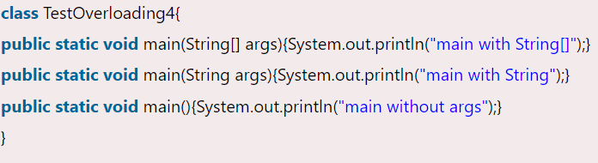
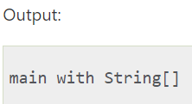
Can we overload java main() method?
Yes, by method overloading. You can have any number of main methods in a class by method overloading. But JVM calls main() method which receives string array as arguments only.

Slide 72
Recursion Method
Recursion is the process of defining something in terms of itself.
As it relates to Java programming, recursion is the attribute that allows a method to call itself.
A method that calls itself is said to be recursive.
The factorial of a number is given as
Factorial n = n! = n × (n-1)×(n – 2)×(n-3) … × 1
This may be written as
Factorial n = n × Factorial (n-1)
For example,
Factorial 4 = 4×Factorial (4-1)
= 4×3×Factorial

Slide 73
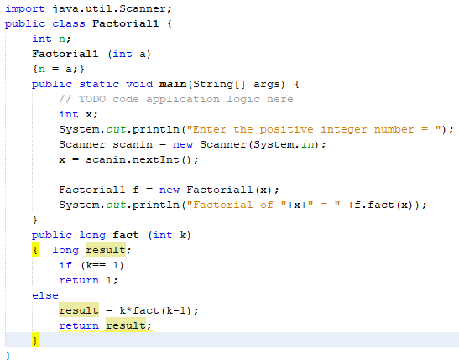
Recursive Example

Slide 74
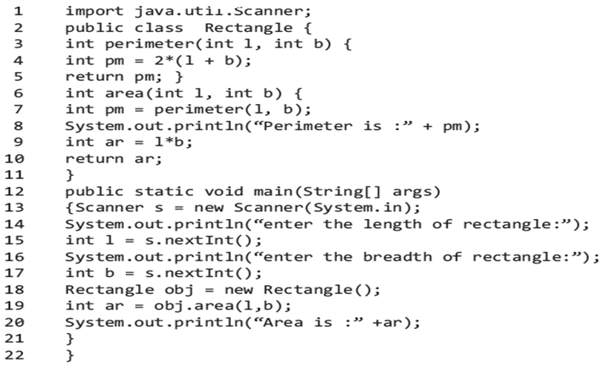
Nesting of Methods
Called another method with in a method

Slide 75
Attribute final
A field can be declared as final.
It prevents its contents from being modified, making it, essentially, a constant.
You can do this in one of two ways:
First, you can give it a value when it is declared.
Second, you can assign it a value within a constructor.

Slide 76
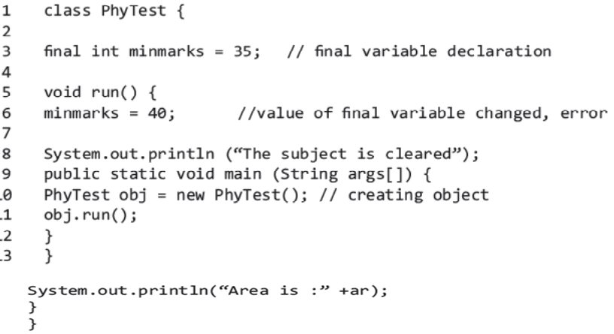
Attribute final example

Slide 77
Static Method
By declaring a method static, it becomes a class method.
Static methods belong to the class, and therefore, it can be accessed without declaring an object of the class.
If any variable is preceded with the keyword static, it becomes a static variable.
For e.g. static int rollno;
Any static method can not access non-static variable directly.

Slide 78
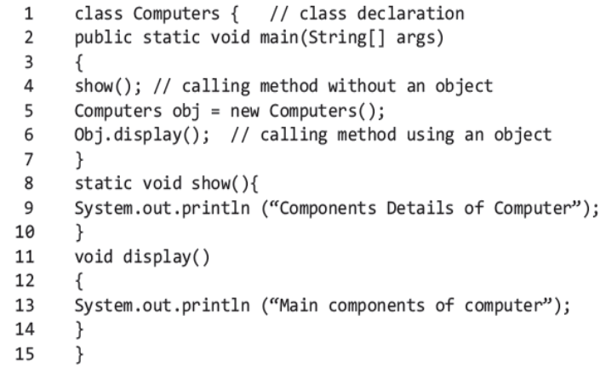
Static Method: An Example

Slide 79
Constructors Overloading
When we have more than one constructors, then it’s constructor overloading in java

Slide 80
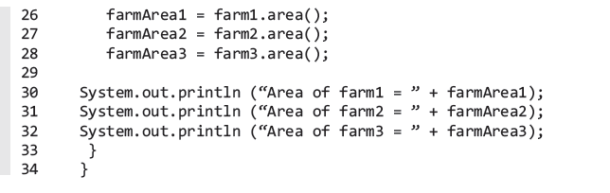
Continue

Slide 81
Thank You

